Slide 1
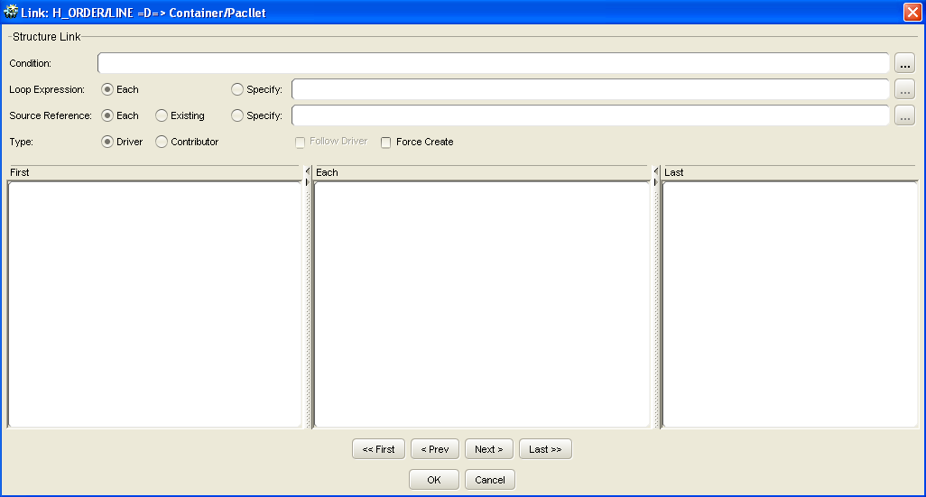
MB Language and Link Code
Structural link
2
3
1
4
5
Shared Services Center | Global Integration & eServices

Slide 2
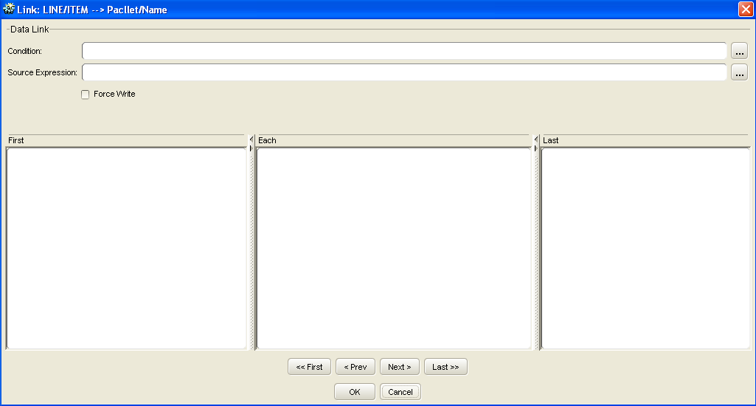
MB Language and Link Code
Data link
2
4
1
3
5
Shared Services Center | Global Integration & eServices

Slide 3
MB Language and Link Code
Link Code
Section | Execution | Used For
First | Executed before the first occurrence of the source view container, also when there are no occurrences. Executed once for each parent container. | Declaration of temporary variables. Declaration of constants. Initialization of variables. Counting of containers.
Each | Executed for each time the link is fired, but before data is provided for the destination. | Calculations. Assignment of variables.
Last | Executed after the last occurrence of the source view container, also when there are no occurrences. Executed once for each parent container. | Verification of variables and detection of errors.
NOTE: variable declarations in the first code of a Contributor type structural link only works if the link does not have a driver parent link. If it does, declare the variable in the Driver link instead.
Shared Services Center | Global Integration & eServices

Slide 4
Structural link
1
Source
Destination
Header
2
Record
Line
3
4
Tail
Shared Services Center | Global Integration & eServices

Slide 5
Structural link
Step1 -〉 info : …… :structure link 1 first
Step2 -〉 info : …… :structure link 1 each
Step3 -〉 info : …… :structure link 2 first
Step4 -〉 info : …… :data link 3 first
Step5 -〉 info : …… :data link 4 first
Step6 -〉 info : …… :structure link 2 each
Step7 -〉 info : …… :data link 3 each
Step8 -〉 info : …… :data link 4 each
Step9 -〉 info : …… :structure link 2 last
Step10 -〉 info : …… :data link 3 last
Step11 -〉 info : …… :data link 4 last
Step12 -〉 info : …… :structure link 1 last
First
Each
Last
Link 1
1
2
12
Link 2
3
6
9
Link 3
4
7
10
Link 4
5
8
11
Shared Services Center | Global Integration & eServices

Slide 6
Structural link
Step1 -〉 info : …… :structure link 1 first
Step2 -〉 info : …… :structure link 1 each
Step3 -〉 info : …… :structure link 2 first
Step4 -〉 info : …… :data link 3 first
Step5 -〉 info : …… :data link 4 first
Step6 -〉 info : …… :structure link 2 each
Step7 -〉 info : …… :data link 3 each
Step8 -〉 info : …… :data link 4 each
Step9 -〉 info : …… :structure link 2 each
Step10 -〉 info : …… :data link 3 each
Step11 -〉 info : …… :data link 4 each
Step12 -〉 info : …… :structure link 2 last
Step13 -〉 info : …… :data link 3 last
Step14 -〉 info : …… :data link 4 last
Step15 -〉 info : …… :structure link 1 last
First
Each
Last
Link 1
1
2
15
Link 2
3
6
9
12
Link 3
4
7
10
13
Link 4
5
8
11
14
Shared Services Center | Global Integration & eServices

Slide 7
Structural link
Step1 -〉 info : …… :structure link 1 first
Step2 -〉 info : …… :structure link 1 each
Step3 -〉 info : …… :structure link 2 first
Step4 -〉 info : …… :data link 3 first
Step5 -〉 info : …… :data link 4 first
Step6 -〉 info : …… :structure link 2 each
Step7 -〉 info : …… :data link 3 each
Step8 -〉 info : …… :data link 4 each
Step9 -〉 info : …… :structure link 2 each
Step10 -〉 info : …… :data link 3 each
Step11 -〉 info : …… :data link 4 each
Step12 -〉 info : …… :structure link 2 last
Step13 -〉 info : …… :data link 3 last
Step14 -〉 info : …… :data link 4 last
Step15 -〉 info : …… :structure link 1 each
Step16 -〉 info : …… :structure link 2 first
Step17 -〉 info : …… :data link 3 first
Step18 -〉 info : …… :data link 4 first
Step19 -〉 info : …… :structure link 2 each
Step20 -〉 info : …… :data link 3 each
Step21 -〉 info : …… :data link 4 each
Step22 -〉 info : …… :structure link 2 last
Step23 -〉 info : …… :data link 3 last
Step24 -〉 info : …… :data link 4 last
Step25 -〉 info : …… :structure link 1 last
First
Each
Last
Link 1
1
2
15
25
Link 2
3
16
6
9
19
12
22
Link 3
4
17
7
10
20
13
23
Link 4
5
18
8
11
21
14
24
Shared Services Center | Global Integration & eServices

